Slide 1
Experiment 02
Level: Easy
(A)
A university administration requires an analytical performance report for each academic unit. Write a PostgreSQL solution to calculate the average marks scored by students grouped by their respective departments. The solution must join the student profile, course subjects, and grade marks tables, returning a breakdown sorted by the highest average marks down to the lowest.
Output
Department | Average Marks
Mathematics | 95.00
Computer Science | 83.33

Slide 2
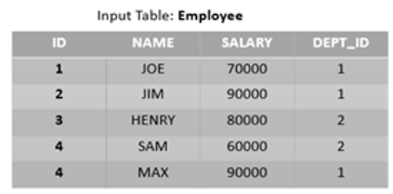
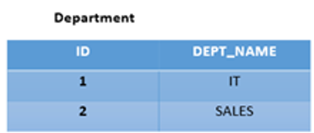
Experiment 02
A multinational organization maintains separate records for employee information and department details. The management wants to identify the employees who receive the highest salary within their respective departments for an annual performance report.
If more than one employee earns the same highest salary in a department, all such employees should be included in the report. The final output should display the Department Name, Employee Name, and Salary, arranged in ascending order of department name.
Note: The employee and department information are maintained in separate normalized tables.

Slide 3
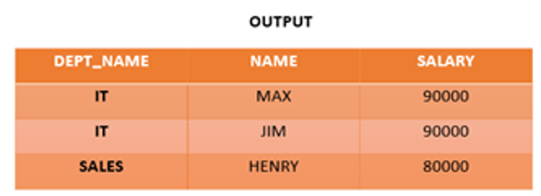
Experiment 02

Slide 4
Experiment 02
Part B: FIND THE 2ND HIGHEST EARNING EMPLOYEE from the same schema.

Slide 5
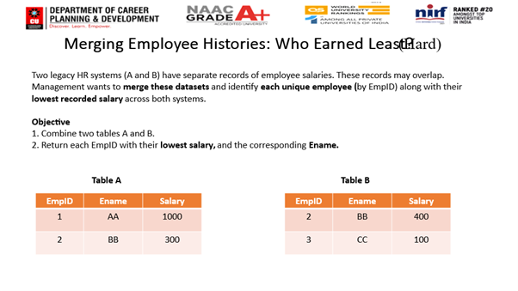
Experiment 02
Level: Medium

Slide 6
Experiment 02
Output
EmpID | Ename | Salary
1 | AA | 1000
2 | BB | 300
3 | CC | 100

